Slide 1
Analytics Employee Attrition
FINAL REPORT
Instructor: Dinh Thuan Nguyen
Minh Nhut Nguyen
01

Slide 2
MEMBERS
TRONG KHANG HO
CAO KHOA NGUYEN
TUAN KHANH LE
01
02
03
02

Slide 3
TABLE OF CONTENTS
OVERVIEW
DATA PREPROCESSING
ALGORITHM & EXPERIMENT
PREDICTION APP
CONCLUSION
1
2
3
4
5
03

Slide 4
OVERVIEW
1
04

Slide 5
RATIONALE
In an organization, workers play an essential role and are the core of bringing the innovation process into depth and promoting the industry.
When someone left at a specific position, it is necessary to have another person replace that position.
Create a machine to make predictions about whether the company is short of personnel, there by helping the leaders to have a better view of issues in the company such as the working environment, salaries, and expenses salary or bonus or are forcing employees to work too much so that there are decisions, future orientations as well as an earlier change in the way the company operates to ensure its human resources. complete and best.
05

Slide 6
AIMS OF THE STUDY
It is possible to process and clean the collected data into a valuable data source for the problem.
Explore, analyze data sets.
Building a natural language data system, using machine learning to train machines to make highly reliable information and predictions for humans.
Compare efficiency and accuracy between models.
Predict employee attrition, help limit damages, and optimize work for the organization.
06

Slide 7
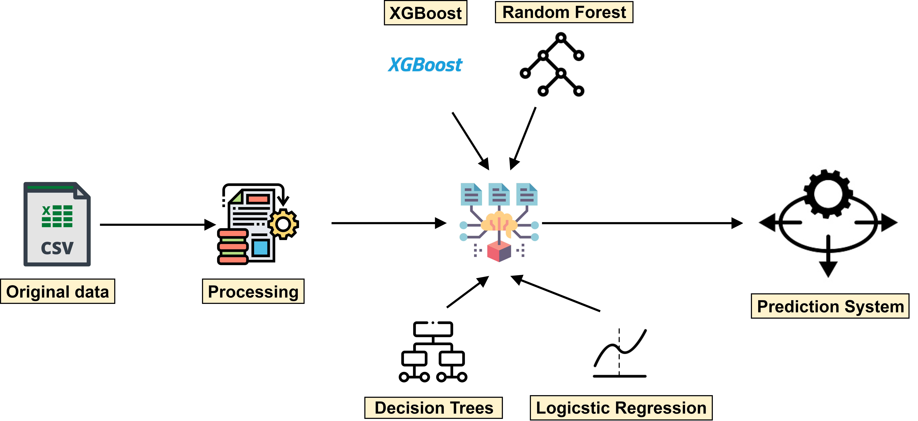
PROCESS OVERVEW
07

Slide 8
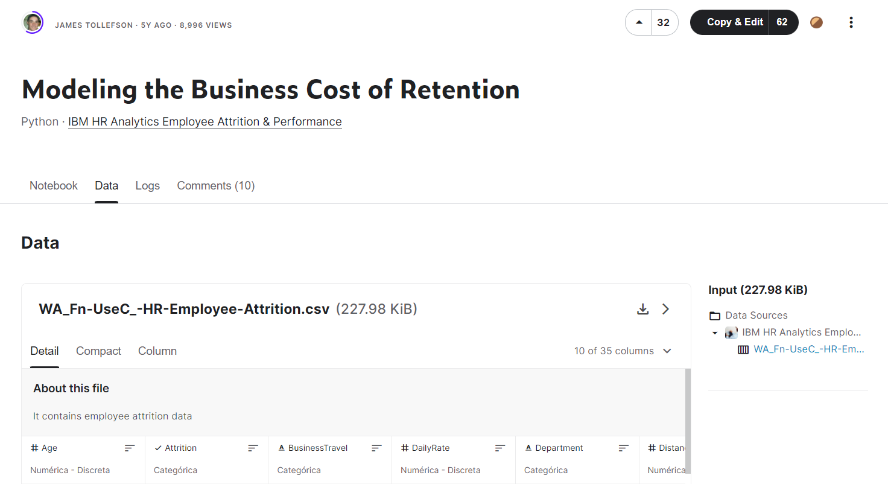
DATASET OVERVIEW
Author : James Tollefson
Information about employees (age, education, rate, role..)
Through which users can know the following information:
Information of 1471 employees
The data store consists of 1471 rows and 35 attributes
08

Slide 9
BTI | Attribute | Property meaning | Property type | Value of property | Average value | Median value | Fashion
1 | Age | Employee's age | Ordinal | From 18-60 | 36.9 | 36
2 | Attrition | Attrition | Nominal | Yes,No
3 | Business Travel | Business travel density | Nominal | Travel_Rarely, Travel Frequently, Non Travel |  |  | Travel _Rarely
4 | Daily_Rate | Wages per day | Ordinal | From $102-1499 | 802 | 802
5 | Department | Department | Nominal | Research & Development, Sales, Human Resources |  |  | Research&Development
6 | Distance From Home | Distance to the house | Ordinal | 1-29km | 9.19km | 7
7 | Education | Education level | Nominal | 1-5 | 2.91 | 3
8 | Education Field | Professional knowledge | Nomial | Life Science, Medical, Marketing, Techical Degree, Other |  |  | Life Science
9 | Employee Count | Number of employees | Ordinal | 1
10 | Employee Number | Employee order number | Ordinal | 1-2068 | 1022 | 1022
11 | Environment Satisfaction | Working environment | Ordinal | 1-5
12 | Gender | Gender | Nominal | Male-Female |  |  | Male
DATASET ATTRIBUTES
09

Slide 10
BTI | Attribute | Property meaning | Property type | Value of property | Average value | Median value | Fashion
13 | Hourly-Rate | Wages per hour | Ordinal | 30-100$ | 65.9 | 66
14 | Job Involment | Productivity at work | Ordinal | 1-4
15 | Job Level | Work level | Ordinal | 1-5
16 | Job Role | Job roles | Nominal | Sale Executive, Research Scientist, Laboratory Technician, Manufacturing Director, Healthcare Respentative |  |  | Sale Executive
17 | Job Satisfaction | Job satisfaction | Ordinal | 1-4
18 | Marital Status | Marital status | Nominal | Married, Single, Divorced |  |  | Married
19 | Monthly Income | Income per month | Ordinal | 1009 – 20000$ | 6500 | 4930
20 | Monthly Rate | Monthly salary | Ordinal | 2094-27000$ | 143000 | 142000
21 | NumCompaniesWorked | The number of companies that have done it. | Ordinal | 0-9 | 2.69 | 2
22 | Over18 | Over 18 years old | Nominal | Y-N |  |  | And
23 | OverTime | Work more | Nominal | Yes-No |  |  | Yes
24 | Percent Salary Hike | Increase salary as a percentage | Ordinal | 11-25 | 15.2 | 14
DATASET ATTRIBUTES
10

Slide 11
BTI | Attribute | Property meaning | Property type | Value of property | Average value | Median value | Fashion
25 | Performance Rating | Assess the performance | Ordinal | 3-4
26 | Relationship Satisfaction | Satisfaction with relationships. | Ordinal | 1-4
27 | Standard Hours | Standard working hours | Ordinal | 80
28 | Stock Option Level | Stock options level | Ordinal | 0-3
29 | Total Working Years | Total number of years worked | Ordinal | 0-40
30 | Training Times Last Year | The number of trainings last year. | Ordinal | 0-6
31 | Work Life Balance | The balance between work and life. | Ordinal | 1-4
32 | Years At Company | The number of years I've been at the company. | Ordinal | 0-40
33 | Years In Current Role | The number of years I have worked in my current position. | Ordinal | 0-18
34 | Years Since last promotion | Number of years since the last promotion | Ordinal | 0-15
35 | Years With Current Manager | Number of years working with current manager | Ordinal | 0-17
DATASET ATTRIBUTES
11

Slide 12
DATA PREPROCESSING
2
12

Slide 13
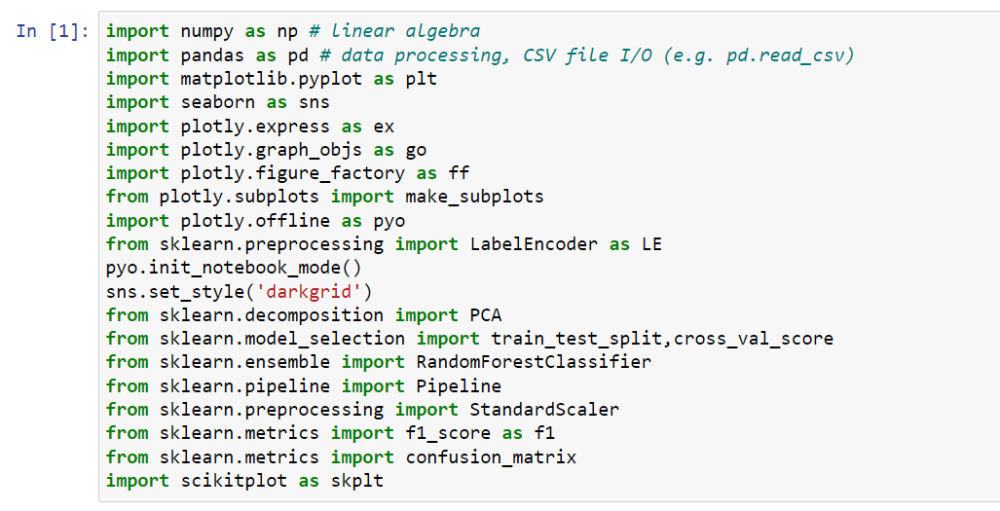
Import package & libraries
13

Slide 14
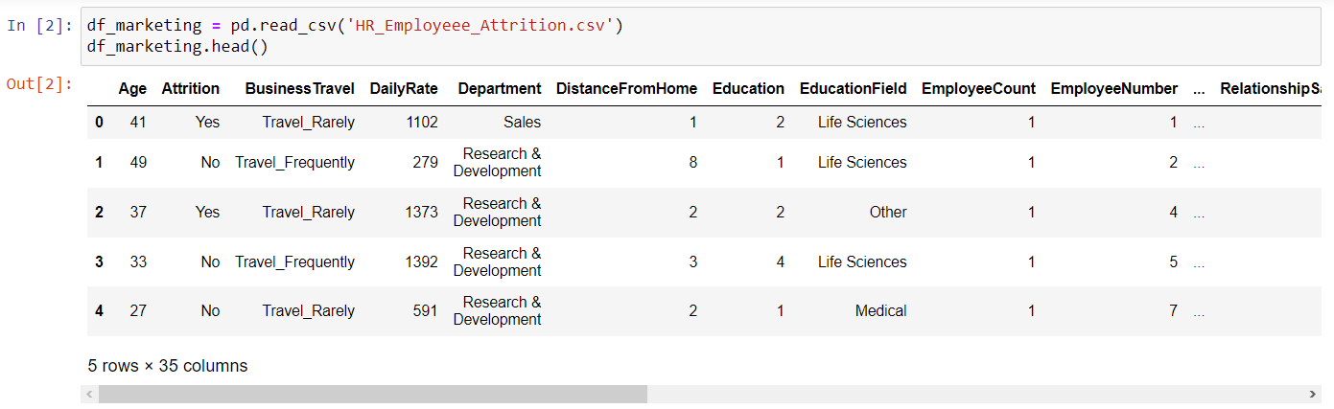
Import data file
14

Slide 15
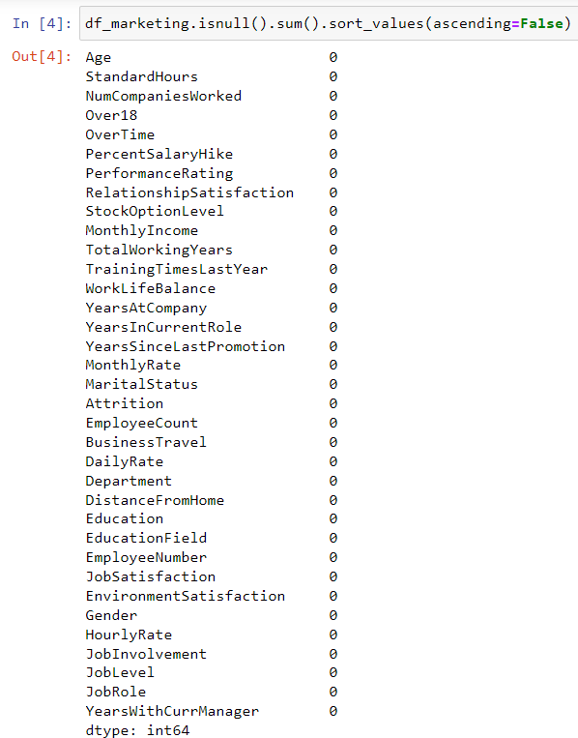
Check null data
15

Slide 16
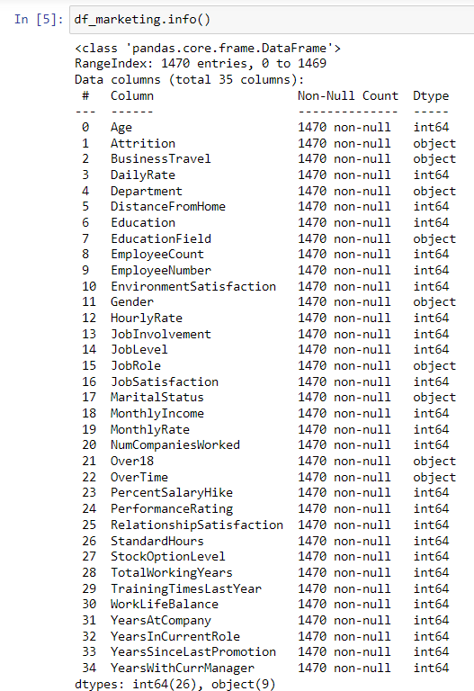
Check data type
16

Slide 17
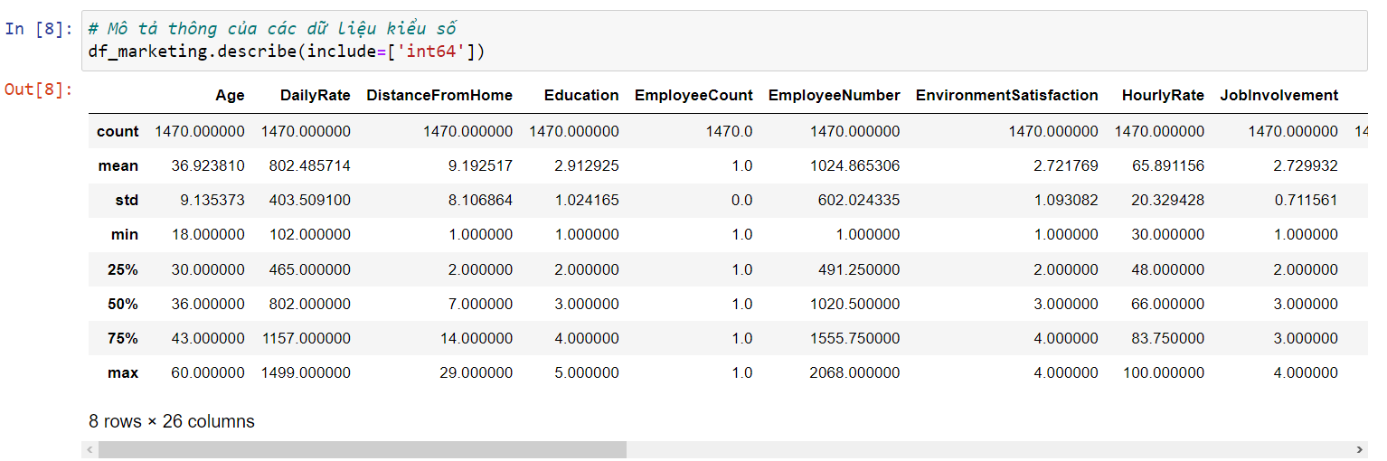
Description of information
numerical data
17

Slide 18
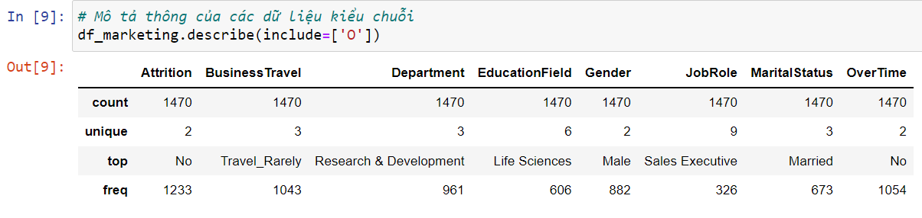
Description of information
non-numerical data
18

Slide 19
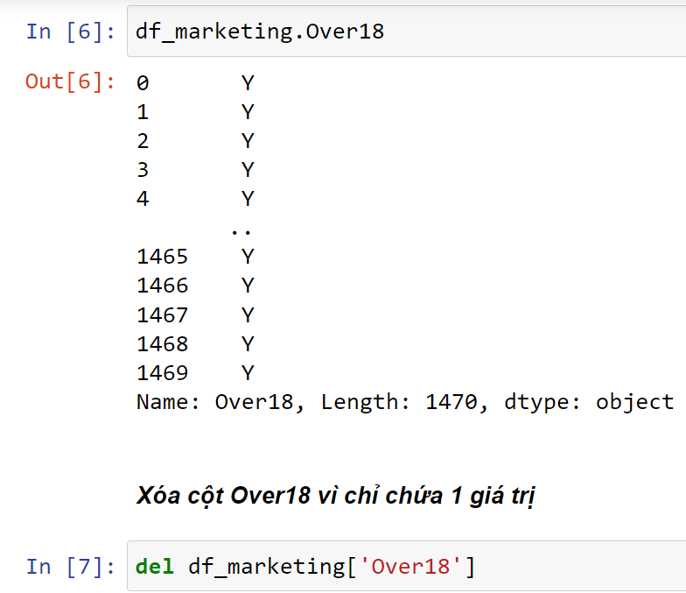
Delete column Over18
19

Slide 20
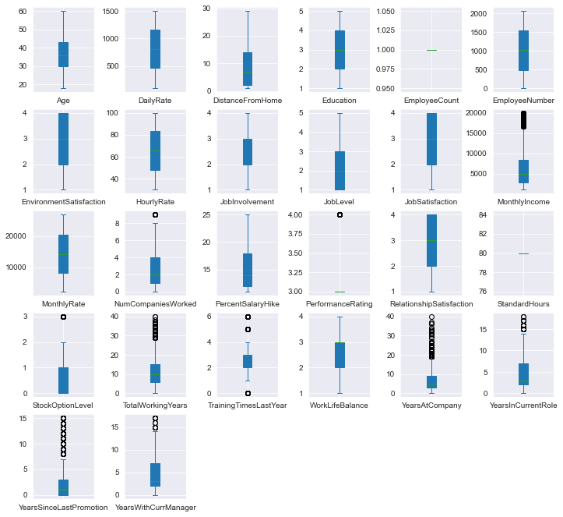
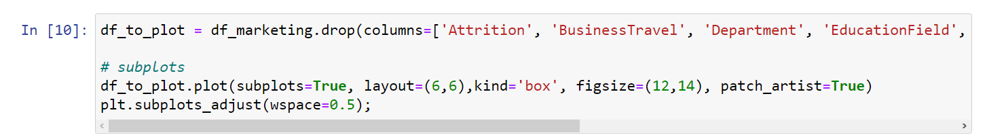
Test Outliers
20

Slide 21
Change the value of the Attrition column from string to boolean
21

Slide 22
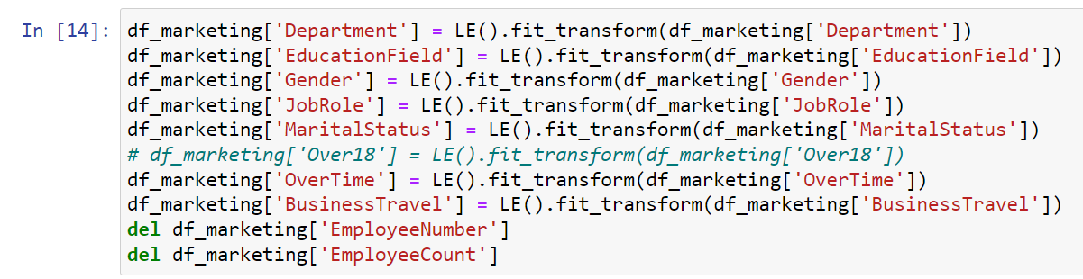
Use Label Encoder to convert data columns from object to numeric type
22

Slide 23
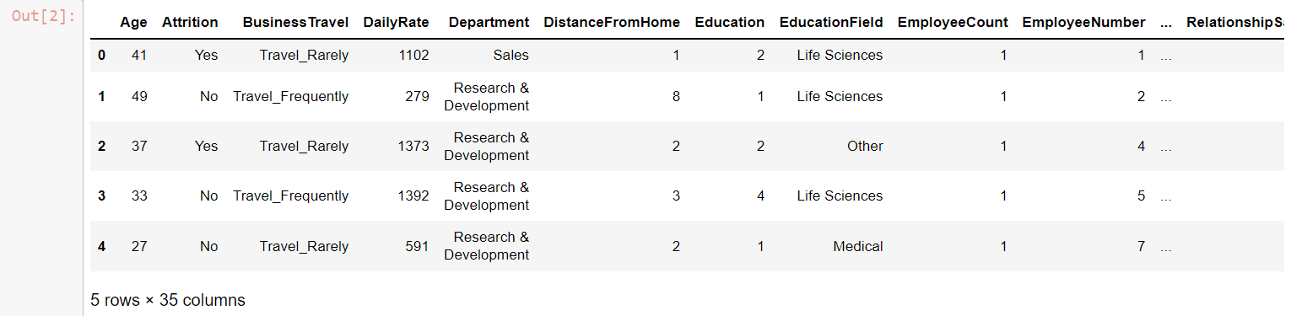
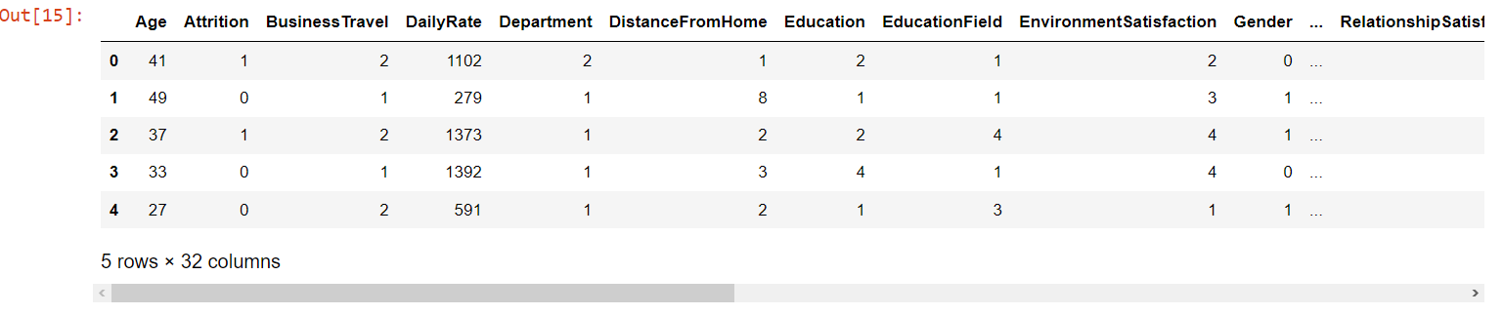
23

Slide 24
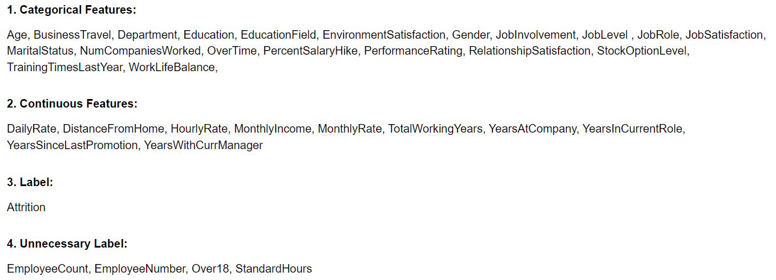
Perform data classification
24

Slide 25
CHI SQUARE TEST (WITH CATEGORICAL FEATURES)
Null hypothesis (H0) : output feature does not depend on input feature
Alternate hypothesis (H1): output feature is dependent on input feature
If we accept the H0 hypothesis, the label does not depend on the input feature being considered and vice versa.
Alpha rating = 0.05
The goal is to get out the features that have an impact on output.
25

Slide 26
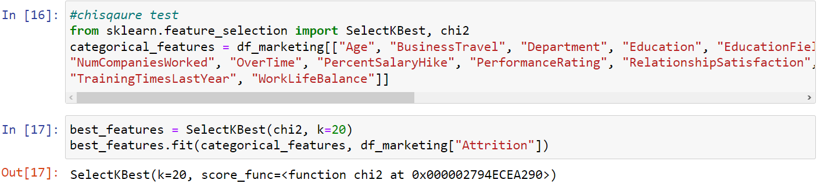
CHI SQUARE TEST (WITH CATEGORICAL FEATURES)
26

Slide 27
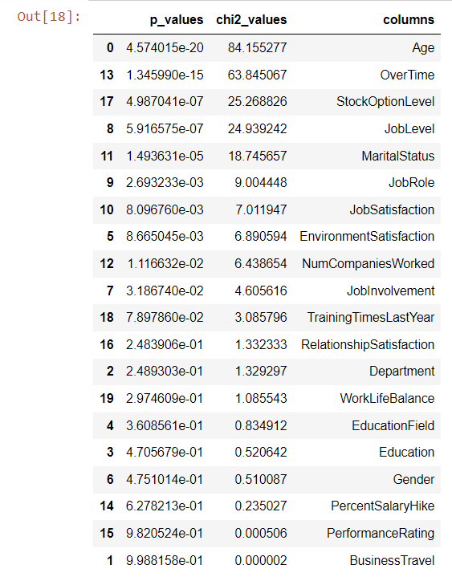
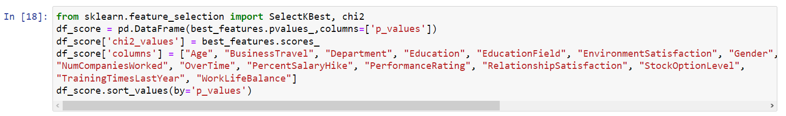
CHI SQUARE TEST (WITH CATEGORICAL FEATURES)
27

Slide 28
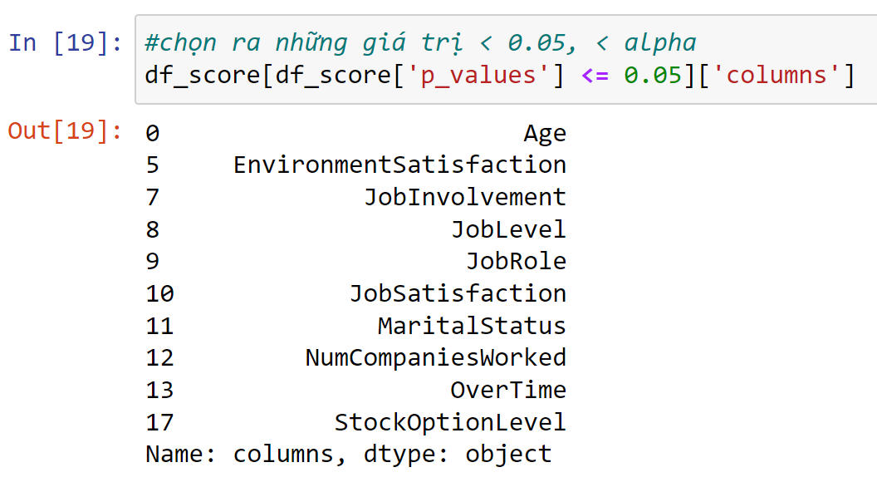
CHI SQUARE TEST (WITH CATEGORICAL FEATURES)
28

Slide 29
ANOVA TEST (WITH CONTINUOUS FEATURES)
Null hypothesis (H0) : 2 groups have the same variance
Alternate hypothesis (H1) : 2 groups have different variances
If we accept the H0 hypothesis, the current input feature does not affect the label and vice versa.
Alpha rating = 0.05
The goal is to get out the features that have an impact on output.
29

Slide 30
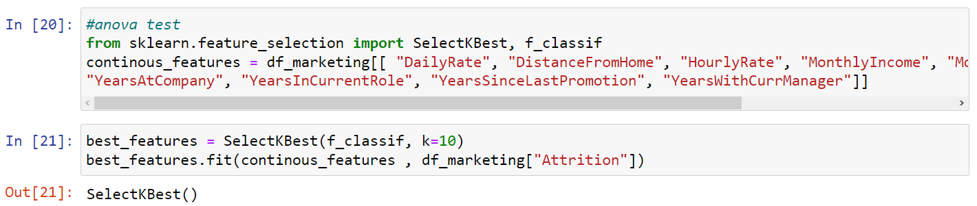
ANOVA TEST (WITH CONTINUOUS FEATURES)
30

Slide 31
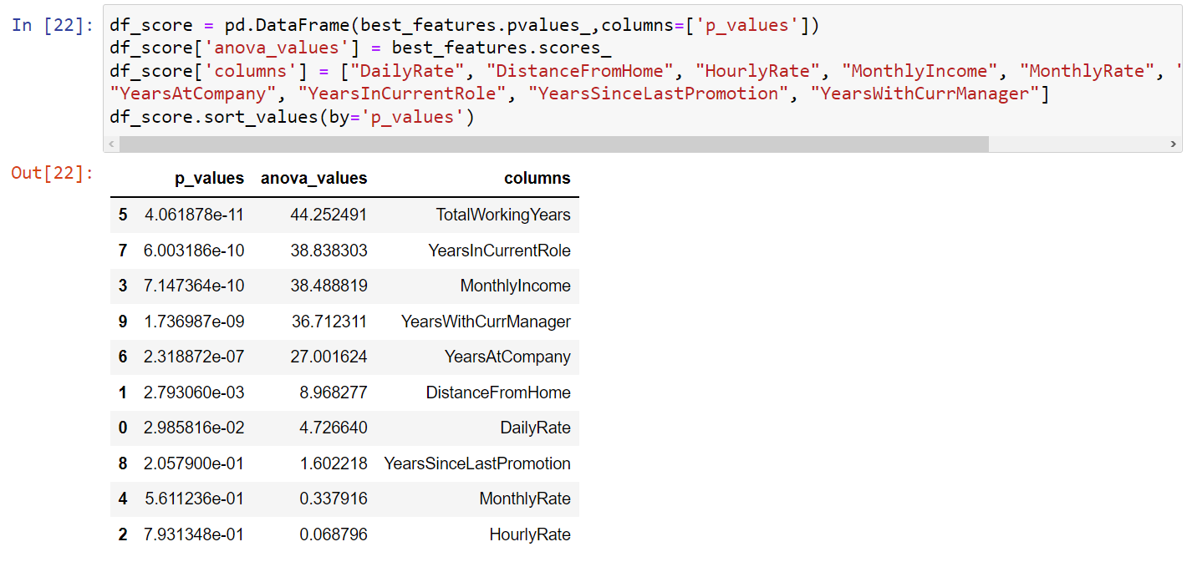
ANOVA TEST (WITH CONTINUOUS FEATURES)
31

Slide 32
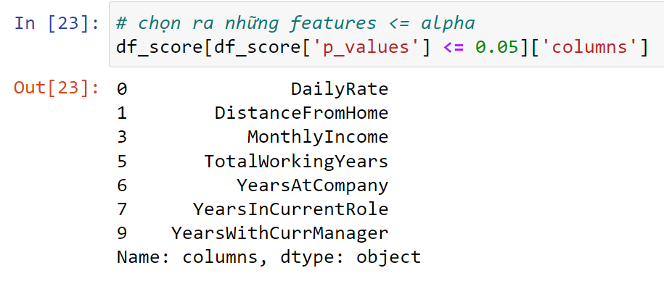
ANOVA TEST (WITH CONTINUOUS FEATURES)
32

Slide 33
ALGORITHMS AND EXPERIMENTS
3
33

Slide 34
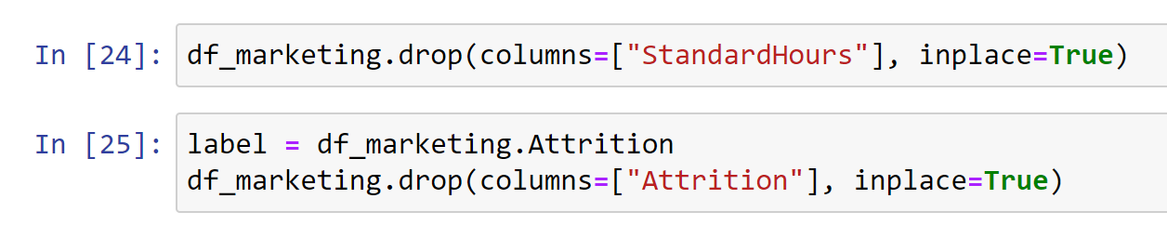
Drop Column is not needed and Separates the decision attribute column into a private column
34

Slide 35
Separating train and test data (train data accounts for 70%, test accounts for 30%)
35

Slide 36

DESICION TREE
36

Slide 37
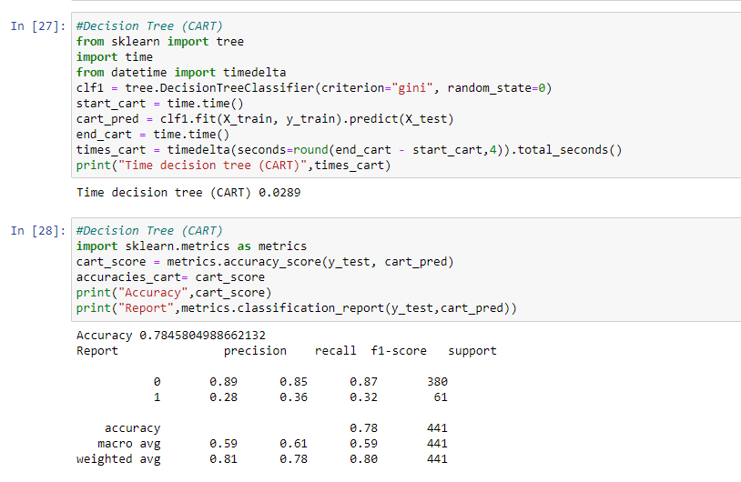
CART
37

Slide 38
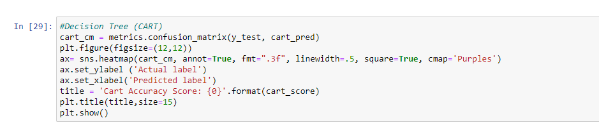
Confusion Matrix
38

Slide 39
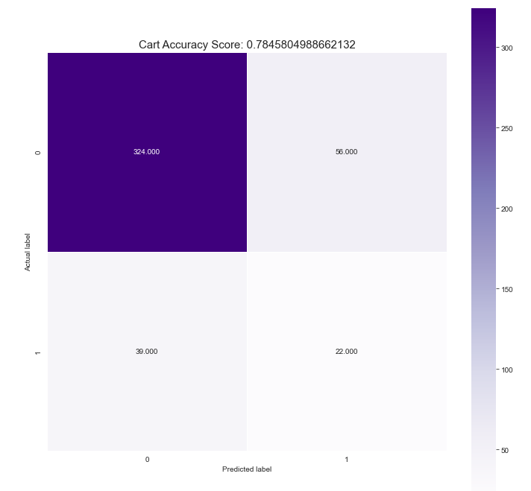
Precision : 89.256%
Recall : 85.263%
F1-Score : 87.213%
39

Slide 40
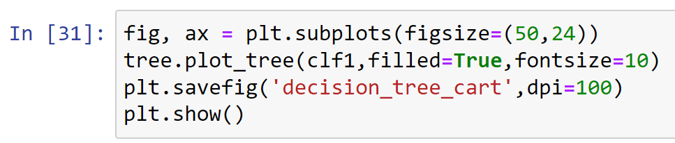
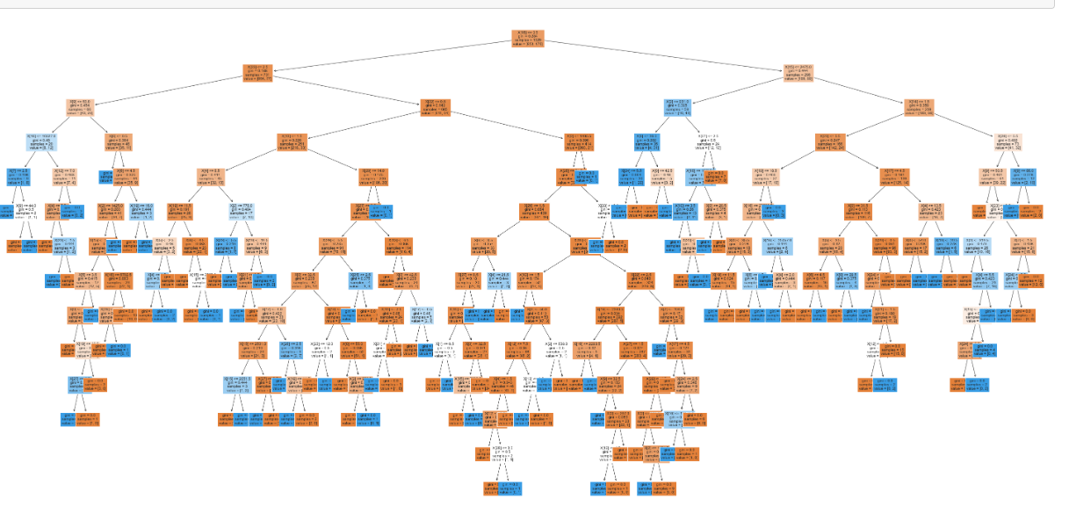
40

Slide 41
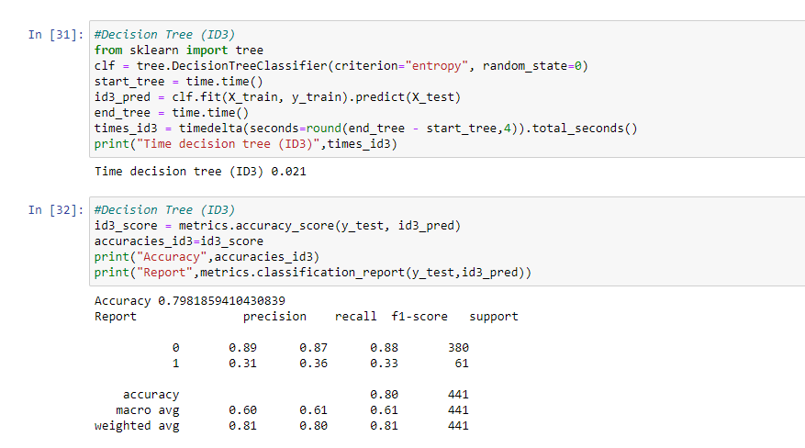
ID3
41

Slide 42
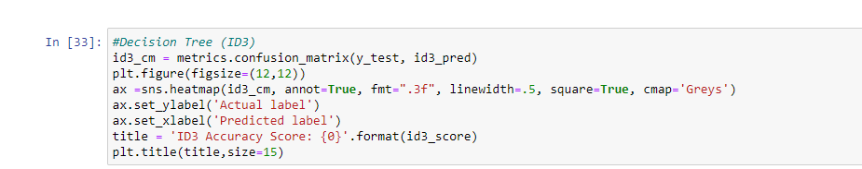
Confusion Matrix
42

Slide 43
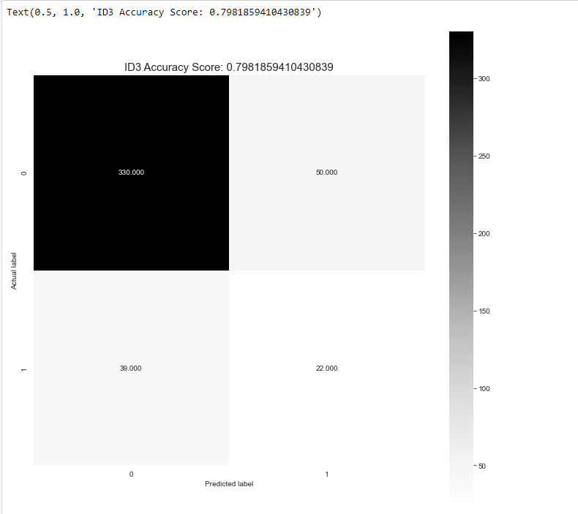
Precision : 89.43%
Recall : 86.84%
F1-Score : 88.11%
43

Slide 44
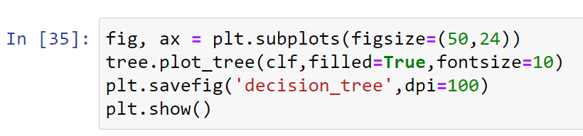
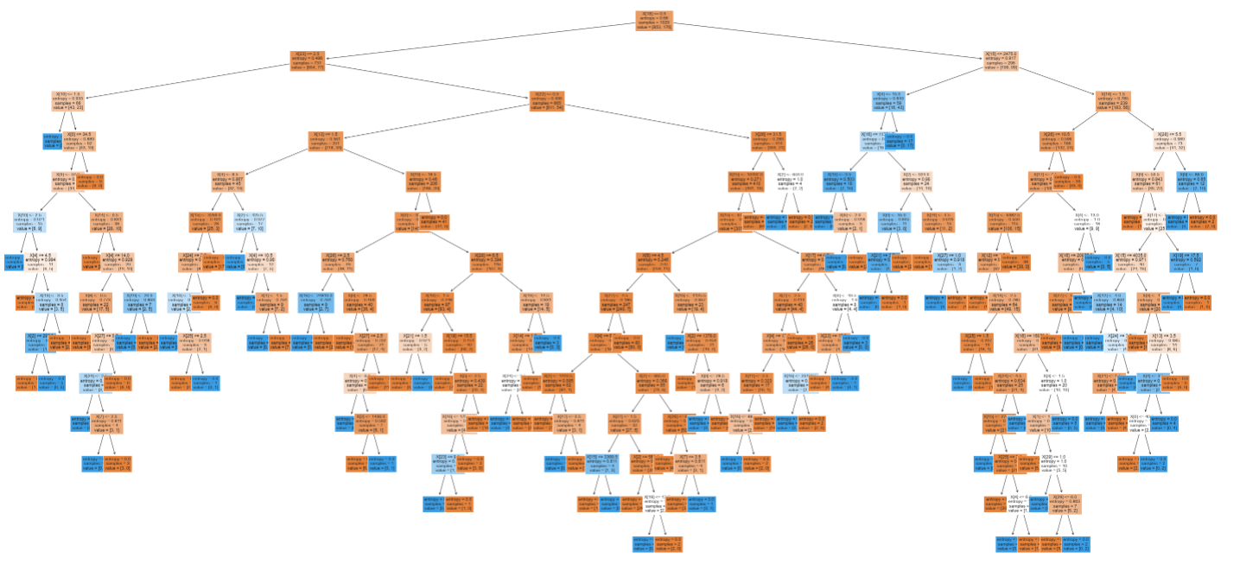
44

Slide 45

RANDOM FOREST
45

Slide 46
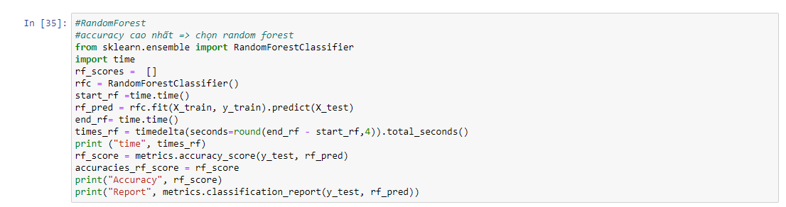
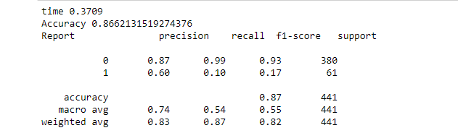
46

Slide 47
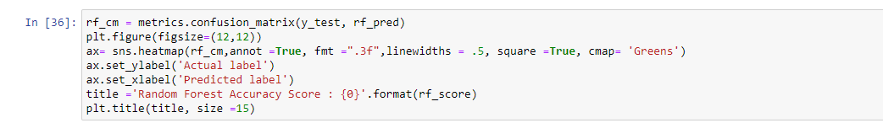
Confusion Matrix
47

Slide 48
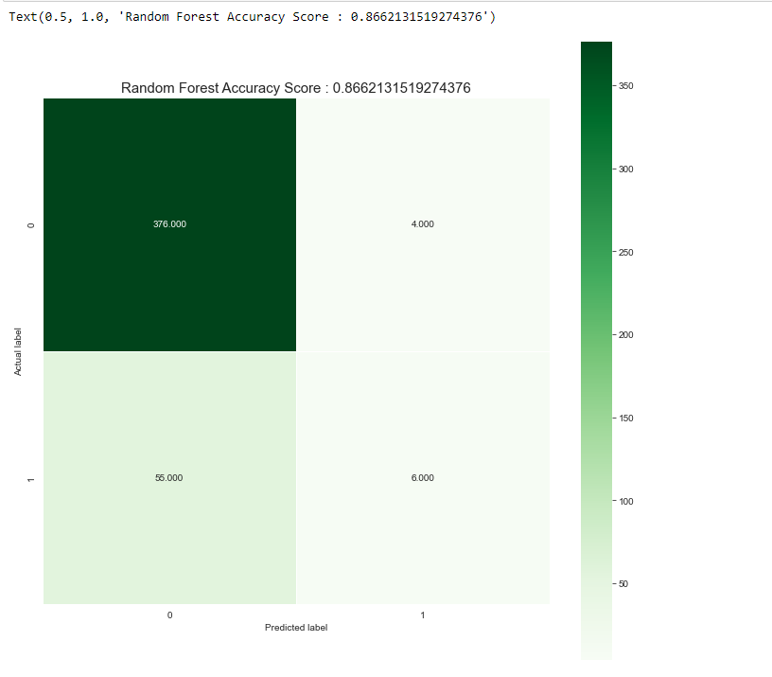
Precision : 87.037%
Recall : 98.94%
F1-Score : 92.607%
48

Slide 49

LOGISTIC REGRESSION
49

Slide 50
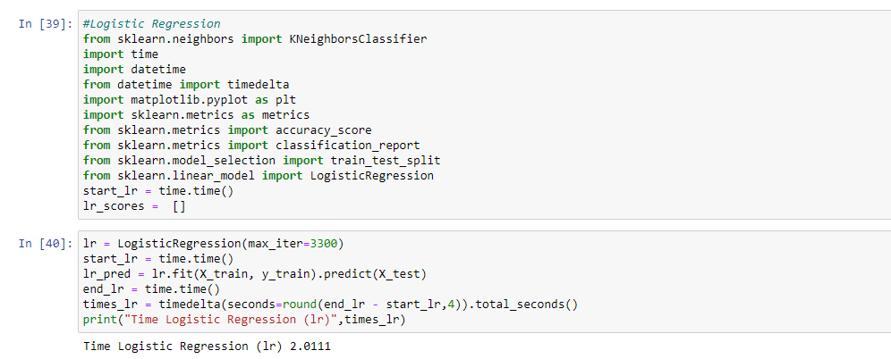
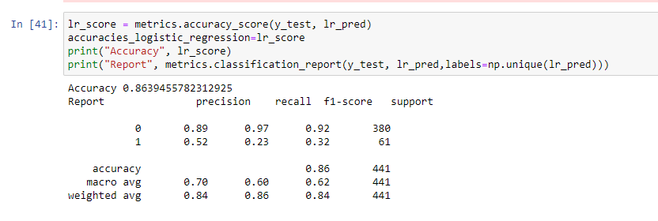
50

Slide 51
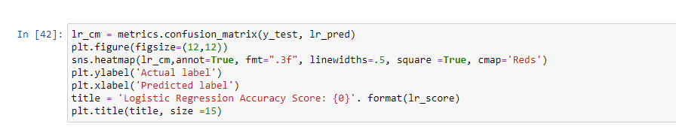
Confusion Matrix
51

Slide 52
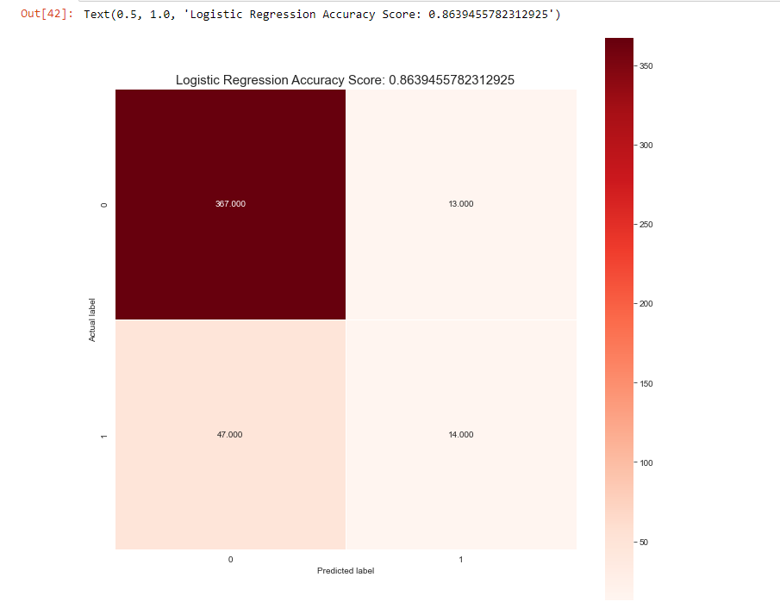
Precision : 88.647%
Recall : 96.578%
F1-Score : 92.44%
52

Slide 53

XGBOOST
53

Slide 54
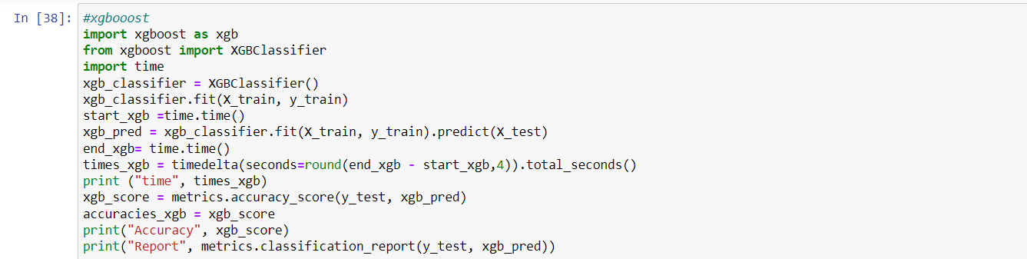
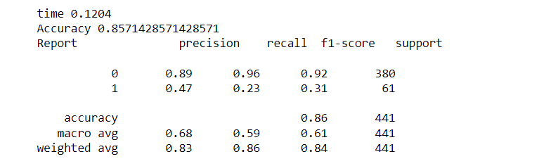
54

Slide 55
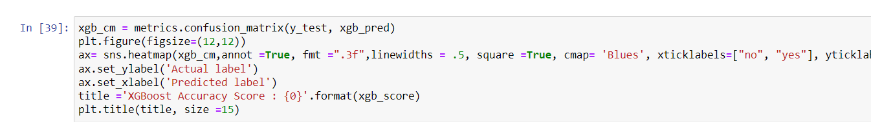
Confusion Matrix
55

Slide 56
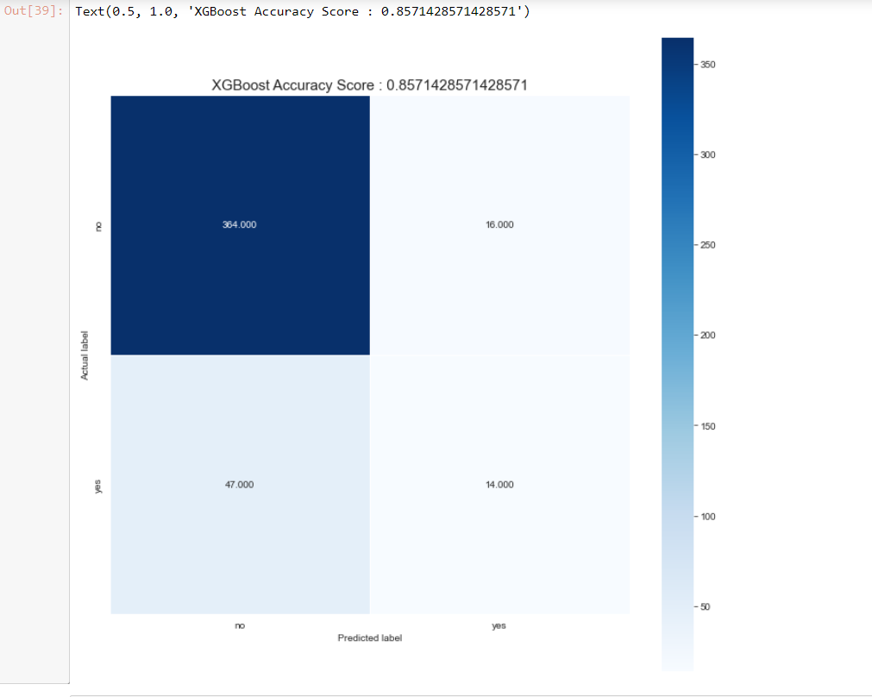
Precision : 88.564%
Recall : 95.78%
F1-Score : 94.913%
56

Slide 57
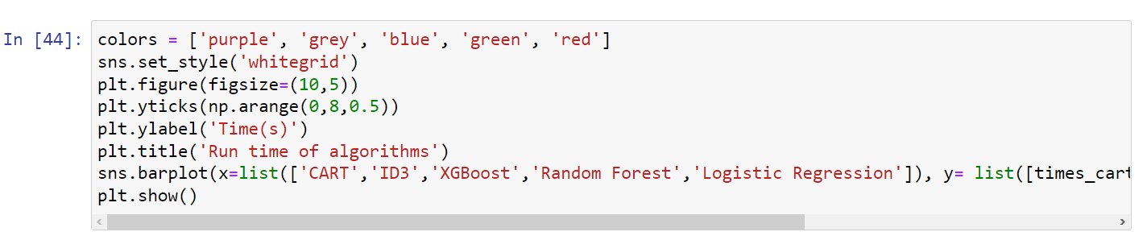
COMPARE THE RUN TIME OF ALGORITHMS
57

Slide 58
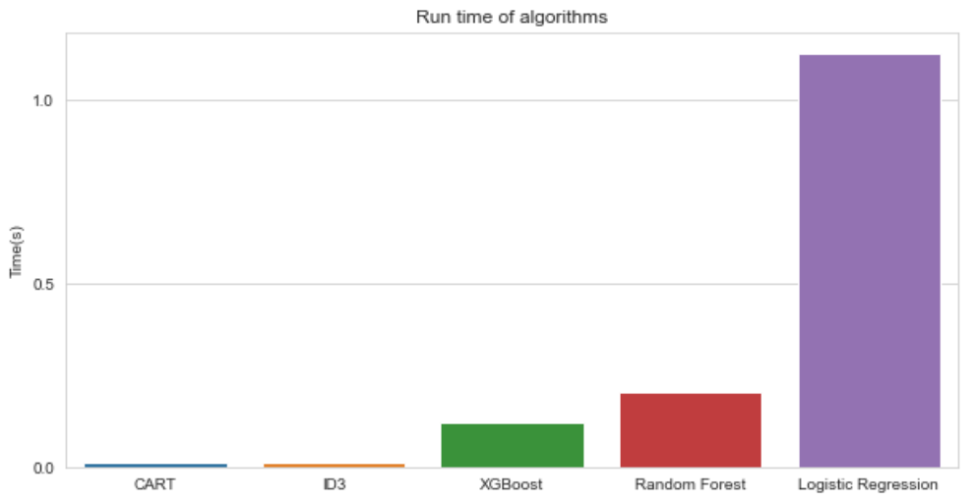
Logistic Regression algorithm is slowest with 2.0111s
58

Slide 59
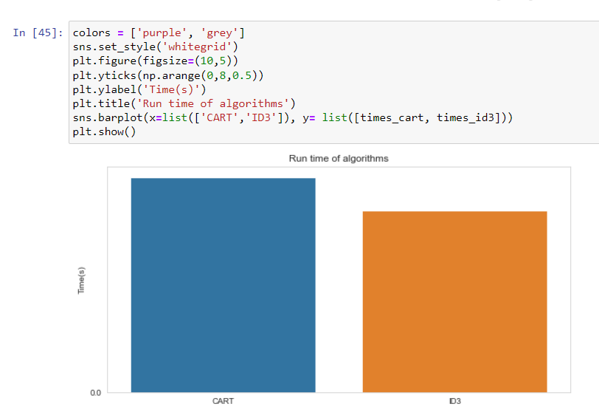
Decision Tree ID3 is the algorithm with the fastest running time for data sets. With only 0.021s
59

Slide 60
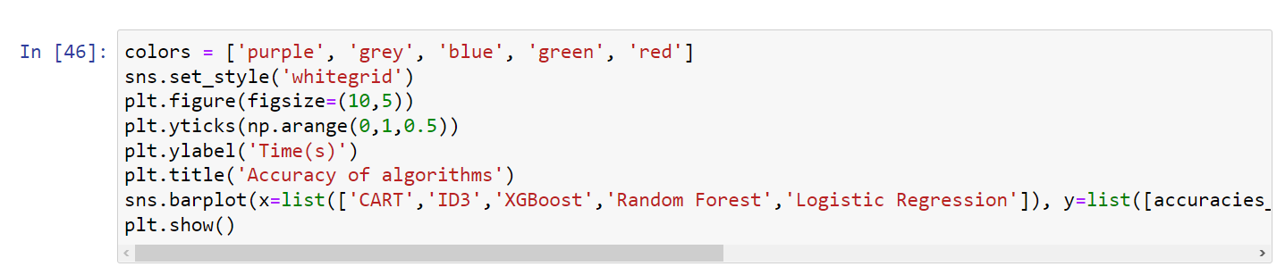
COMPARE THE ACCURACY OF ALGORITHMS
60

Slide 61
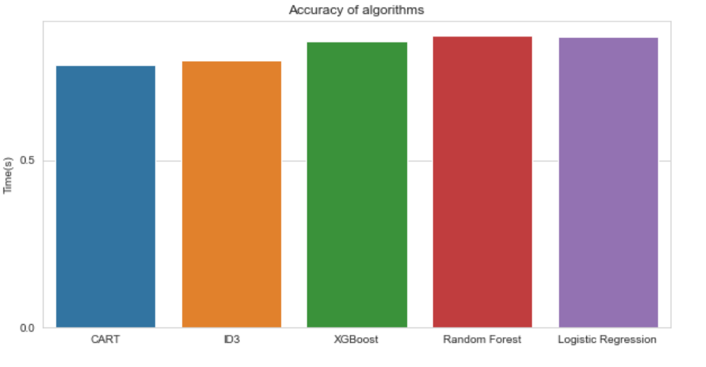
Random Forest has the highest accuracy with 86.61%
The Decision Tree CART has the lowest accuracy with 78.45%
61

Slide 62
PREDICTION APP
4
62

Slide 63
ALGORITHM USED
Use Random Forest algorithm for this software. Although the speed is not too good, but it is strange for the highest accuracy.
63

Slide 64

ATTRIBUTES USED
64

Slide 65

ATTRIBUTES USED
65

Slide 66
DEMO
66

Slide 67
CONCLUSION
5
67

Slide 68
 |  | Advantage | Limitations
 | Decision Tree | Simple, intuitive Training dataset doesn't have to be too large No need to make initial assumptions Can be applied flexibly to target variables,.. | Variance value is high Training and testing datasets must be perfectly prepared Only works effectively on a simple dataset that has few data variable,…
 | Random Forest | Improve with the decision tree algorithm, which solves the noise when the dataset changes | The main disadvantage of Random Forest is the large volume of calculations
 | Logistic Regression | Good layering when data is linearly separable Easy to deploy and train | Easily affected by noise. It is not possible to solve non-linear problems Sensitive to overfitting
 | XGBoost | Can be used to solve many problems such as regression, classification. Support on a variety of source codes Flexibility | The computing time of the algorithm
68

Slide 69
DEVELOPMENT DIRECTION
Research and learn more about datasets, re-adjust properties and preprocessors for greater accuracy.
Continue to apply other algorithms of Business Data Analyst such as Linear Regression or Arima model.
69

Slide 70
THANK YOU FOR YOUR ATTENTION!
70

